Slide 1


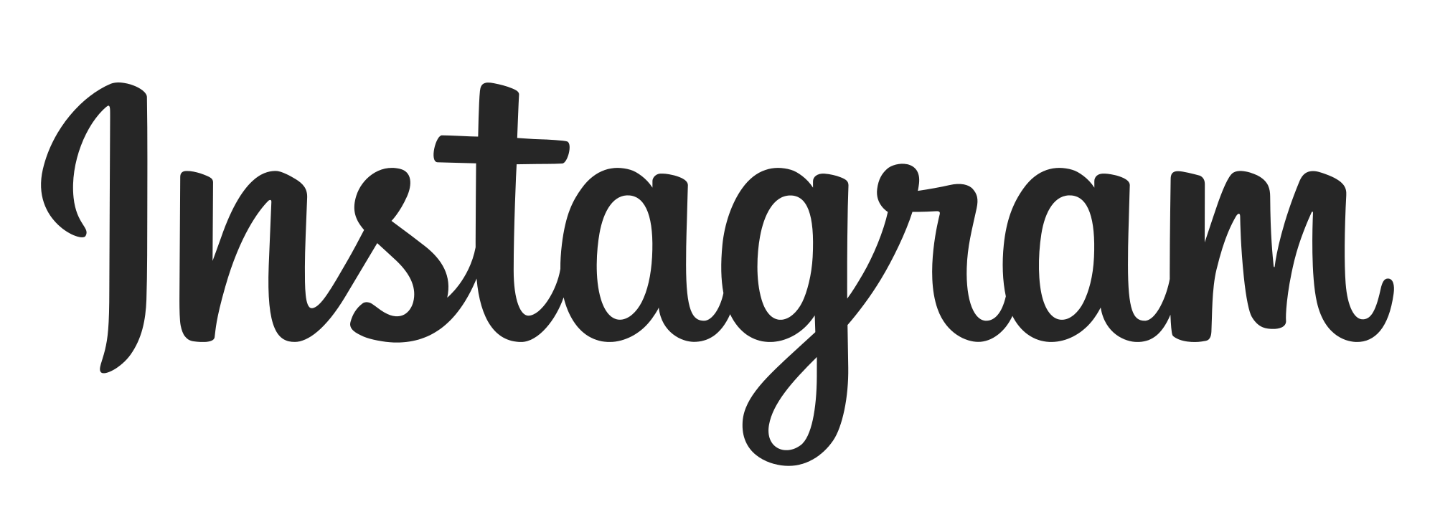
Instagram User Analytics
A Project By : Hemant Murkute

Slide 2
Instagram User Analytics
PROJECT DESCRIPTION: Analyzing user behavior and engagement on the Instagram platform to uncover actionable insights that can support business growth. User behavior analysis focuses on monitoring how individuals interact with a digital product, such as a mobile app or software application. The insights gained through this analysis can be utilized by multiple teams within the organization to enhance product strategy and user experience. I will leverage my SQL expertise to address the queries posed by the Instagram product team.

Slide 3
Queries Raised: Marketing Team
Top 5 users with the longest usage duration.
Identify inactive users.
Find the user with the most likes on a single photo.
Determine the top 5 most popular hashtags.
Identify the best day to launch ads.

Slide 4
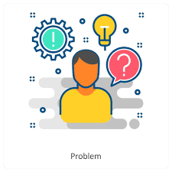
Queries Raised (Investors)
How many posts does a user make on Instagram?
Identify fake or dummy users.

Slide 5
Approach
Received a dataset and created a database.
Analyzed the dataset and checked table relationships (e.g., foreign keys).
Executed SQL queries to extract the required data.
Tech-Stack Used:
SQL: To query the database and extract insights.
MySQL Workbench: Chosen for its ease of use and open-source availability.
PPT: To prepare and present the findings.

Slide 6
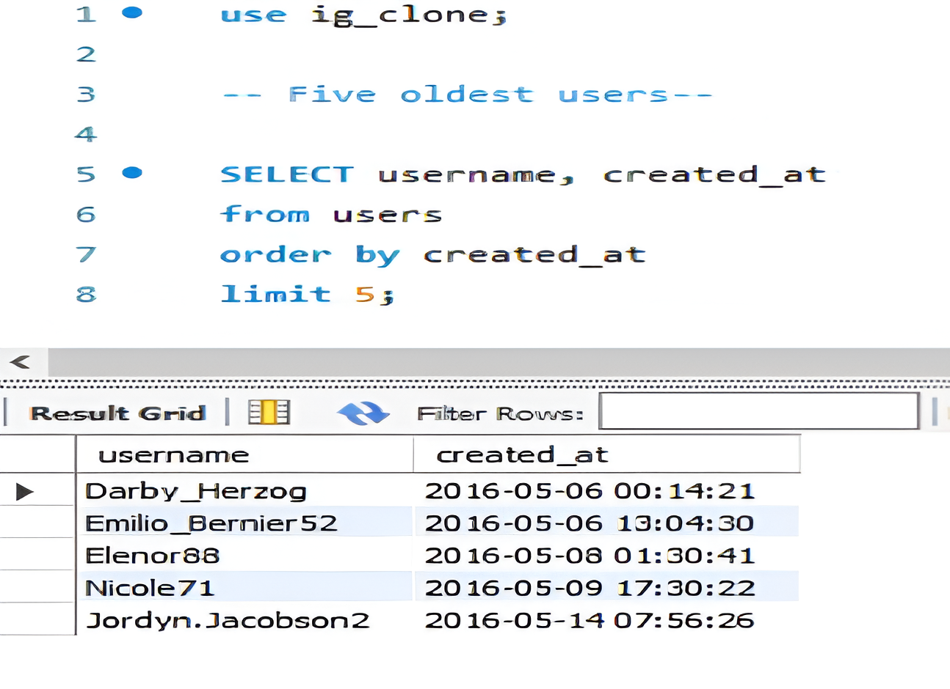
Key Insights (Part 1)
1.Identified top 5 users with the longest Instagram usage duration.

Slide 7
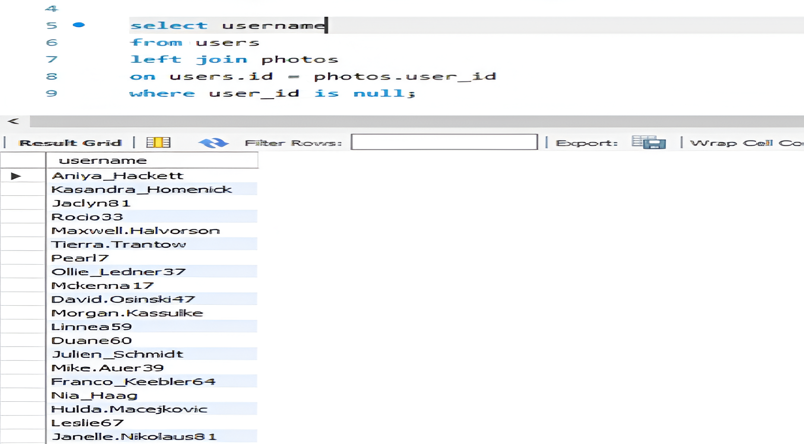
Key Insights (Part 1)
2. Determined inactive users who have never posted photos.

Slide 8
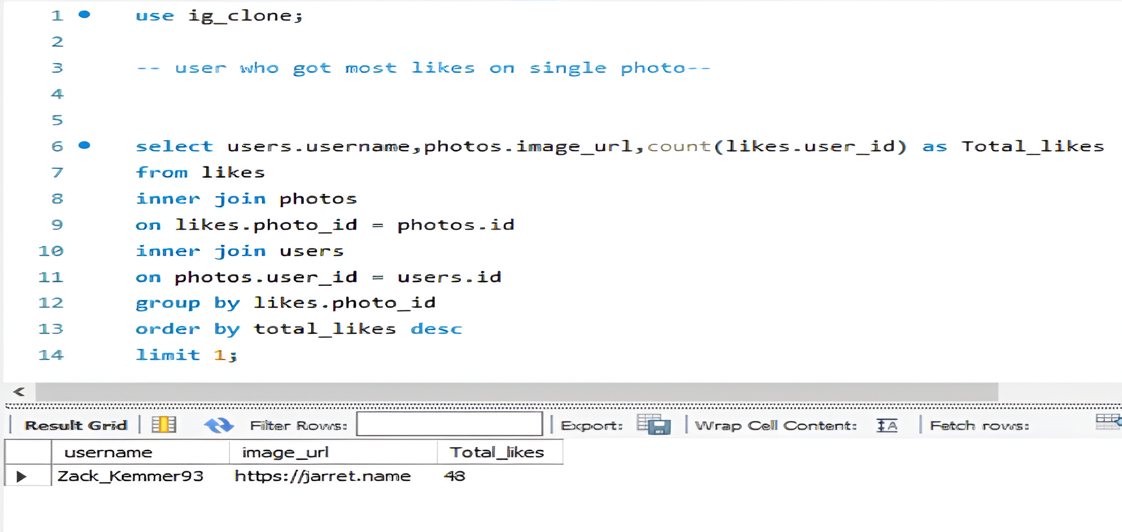
Key Insights (Part 1)
3.Found the user with the highest likes on a single photo.

Slide 9
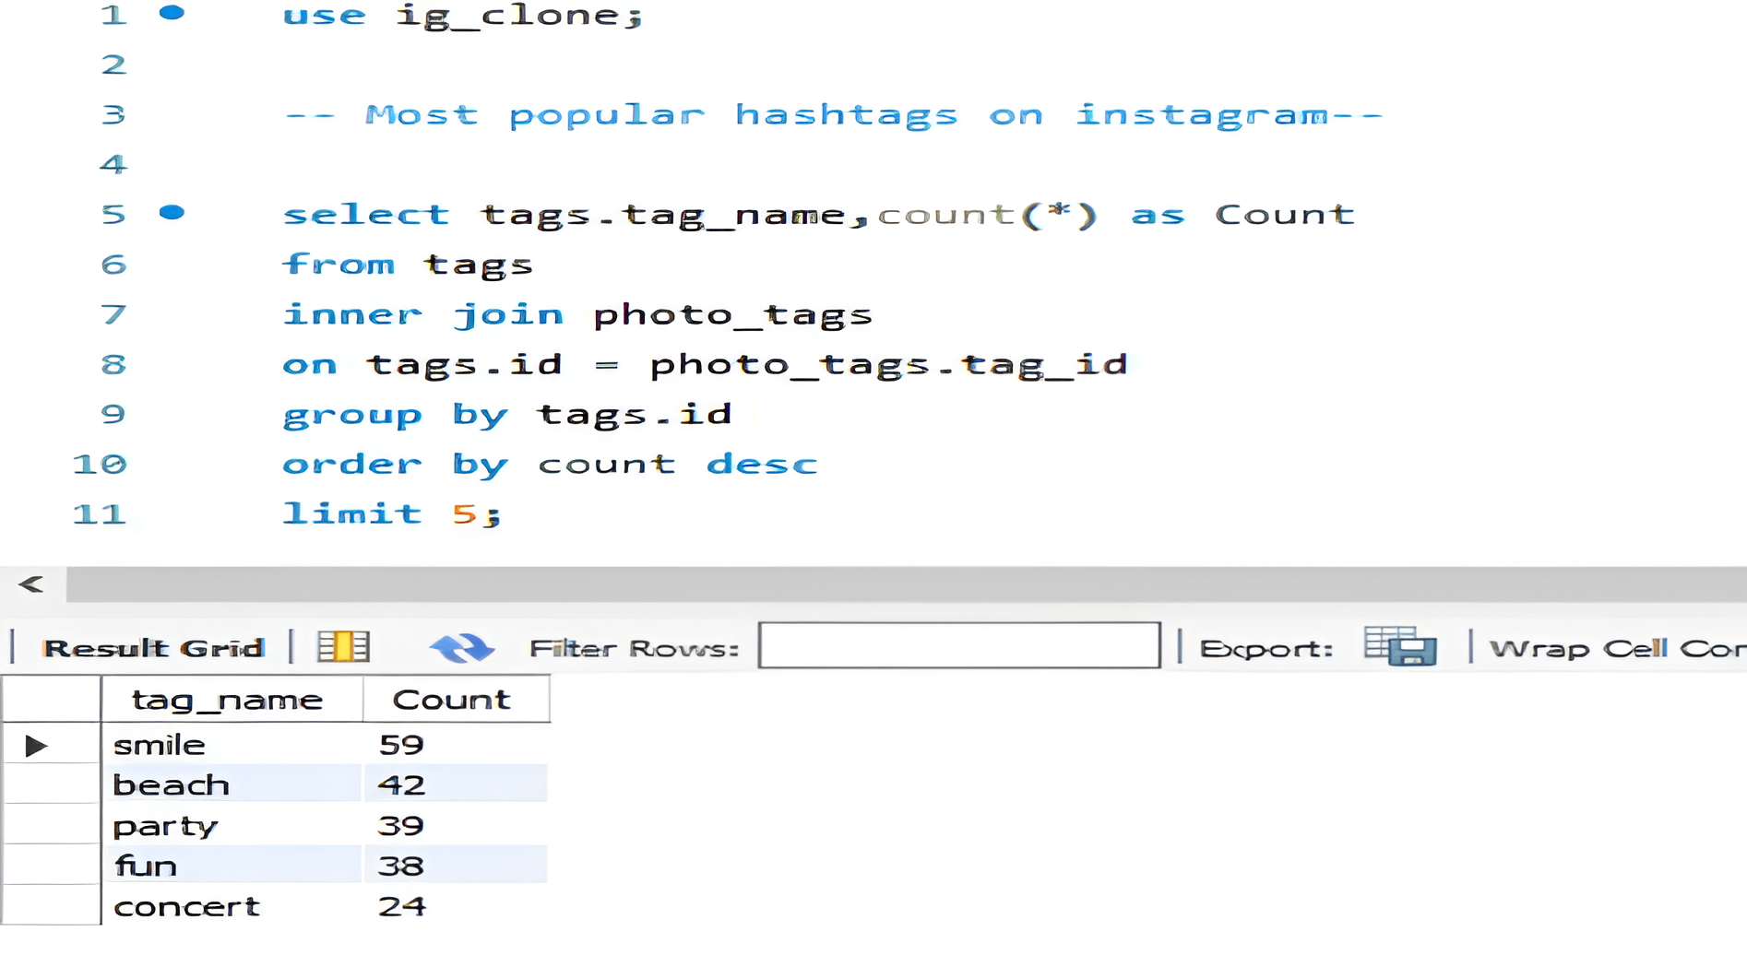
Key Insights (Part 1i)
4.Listed the top 5 most commonly used hashtags.

Slide 10
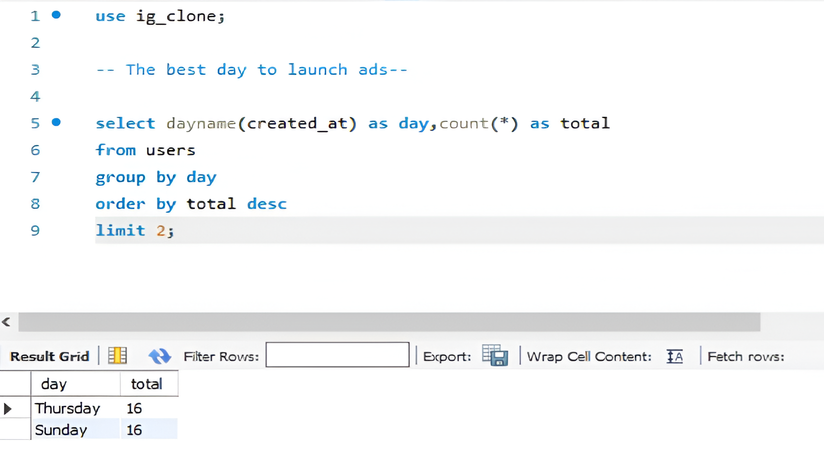
Key Insights (Part 1i)
5.Identified the best day for launching ads.

Slide 11
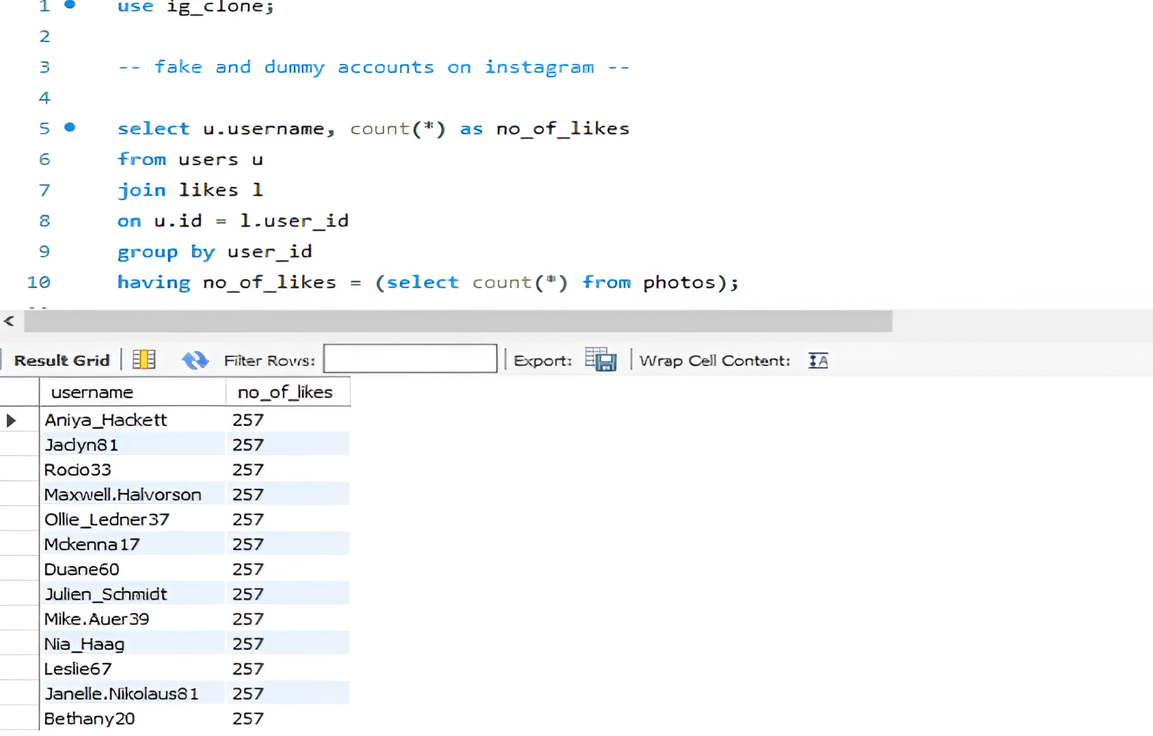
Key Insights (Part 1i)
6.Found fake or dummy users on the platform.

Slide 12
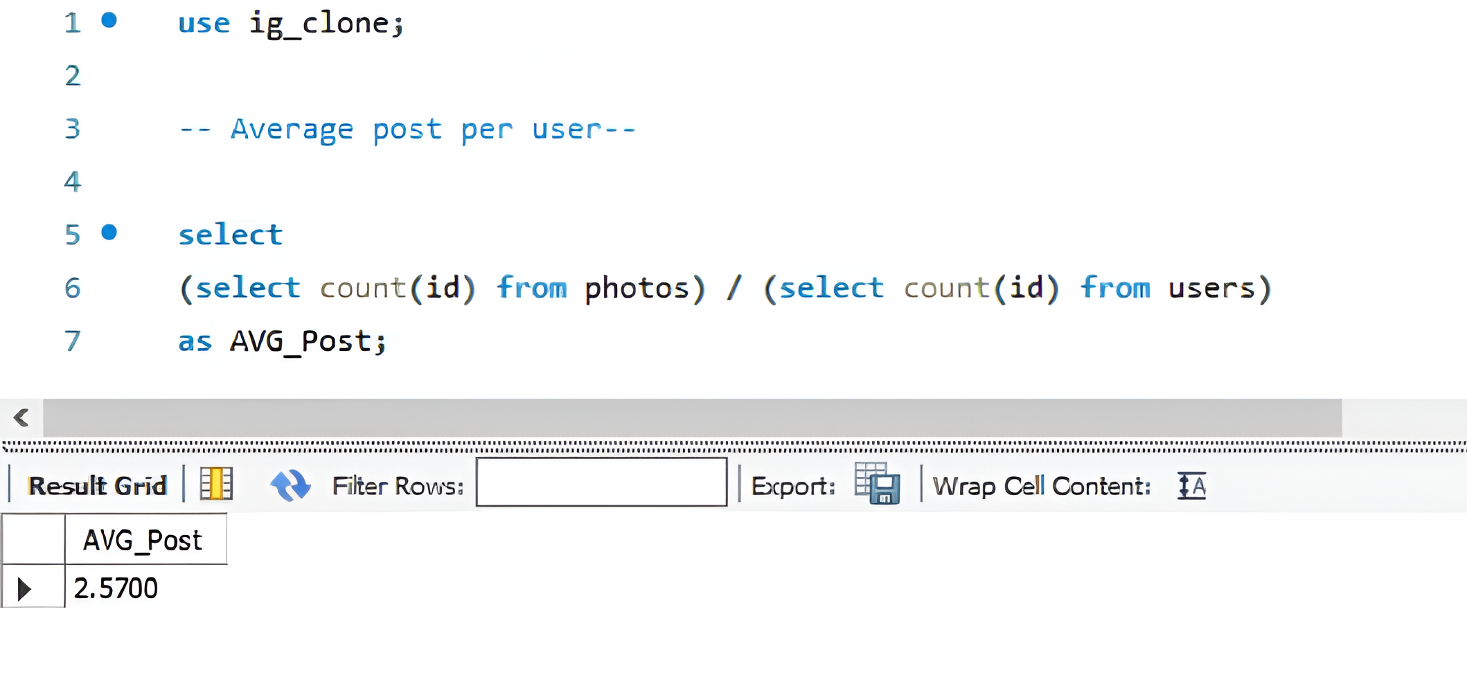
Key Insights (Part 1i)
7.How many posts a user is making on Instagram?

Slide 13
Results
Delivered actionable insights for marketing strategies.
Identified opportunities for user engagement improvements.
Provided data-driven recommendations to stakeholders.

